Slide 1

Online Private Tutor Finder System
Ankita Bajracharya [11815/073]
MansuDHa Bajracharya [11845/073]
Sujata Gautam [11873/073]

Slide 2
Table of contents:
Introduction
Problem Definition
Objectives
Methodology
Algorithms to use
Use case Diagram
Working mechanism
Scope
Limitations

Slide 3
Introduction:
Online private tutor finder system is a kind of classified system where a student and tutor connect each other as per his/her requirement and get benefited from this system.
It will help student for finding best tutor by searching from listed account and recruit them and tutors can get tutoring jobs as well.

Slide 4
Problem Definition:
It can be very tricky to know where to look and find a tutor if you don’t have any connections.
This project aims at developing web-based system with the aim of making it easier for parents and students to instantly find and connect with hundreds of tutors in one place.
This system will provide students a platform for finding the tutors of their desired field/subject according to their qualifications and experience.

Slide 5
Objectives:
To help students find tutor from subject and hourly rate.
To get a student just by logging onto the website and setting up the profile by the tutor.
To help a parent find tutors without consulting any third party.

Slide 6
Methodology:
Requirement identification:
Study of existing system:
Feasibility study:
Technical
Operational
Economical
Tools & techniques:
Analysis and design tools

Slide 7
Implementation tools
Front end tools
HTML
CSS
Javascript
Bootstrap
Backend tools:
Php
Mysqli
Xampp server

Slide 8
Algorithms To use
Price-based filtering algorithm

Slide 9
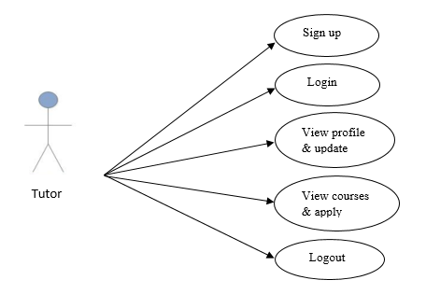
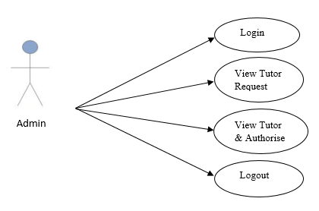
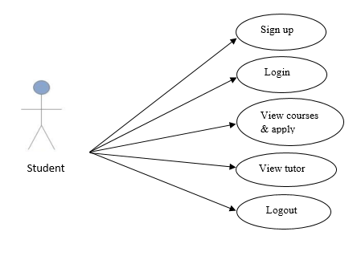
Use case diagram

Slide 10
Scope
Tutor will get a market to explore himself as a teacher.
A tutor can teach according to his suitable time and from his own place and a student can learn at a time that suits him from his home itself without the hassle of commute.

Slide 11
LIMITATIONS
Cancellation is not available.
Age limitation for tutor is under 16.
This will be available to people in only two cities currently.

Slide 12
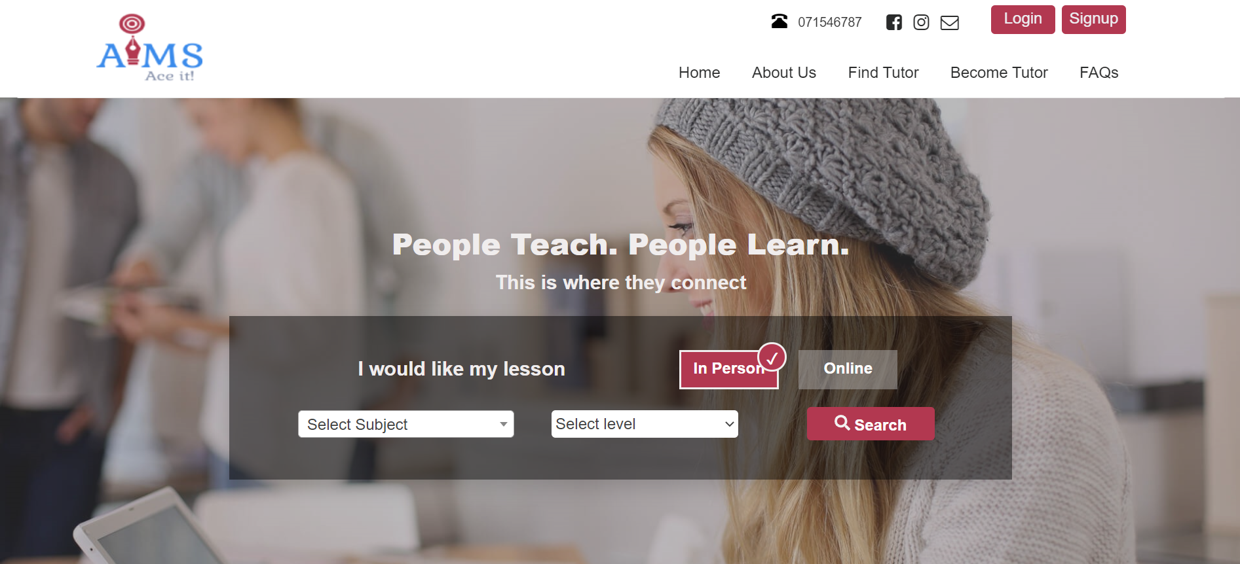
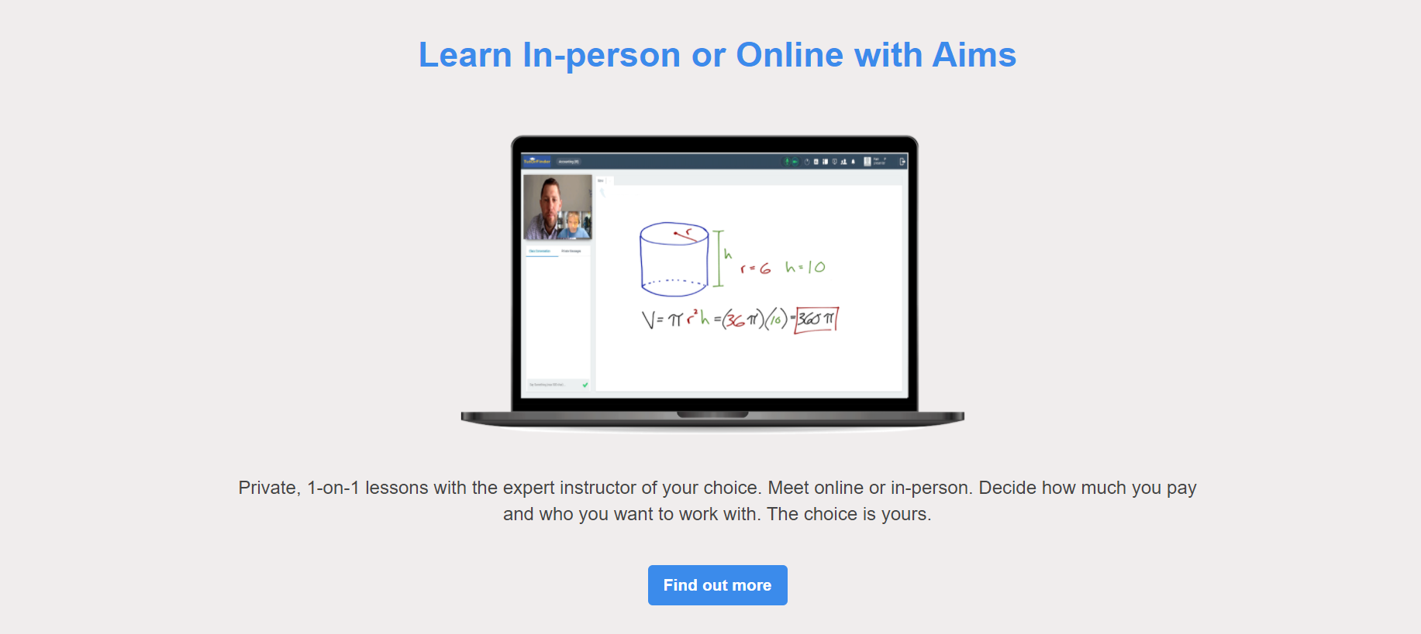

Slide 13
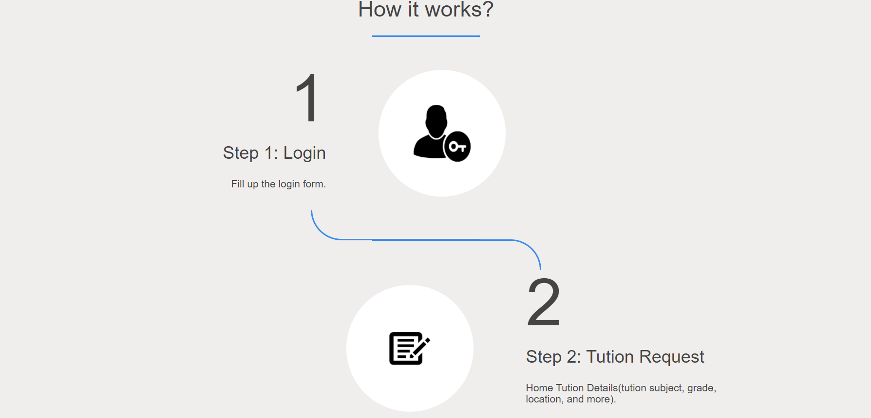
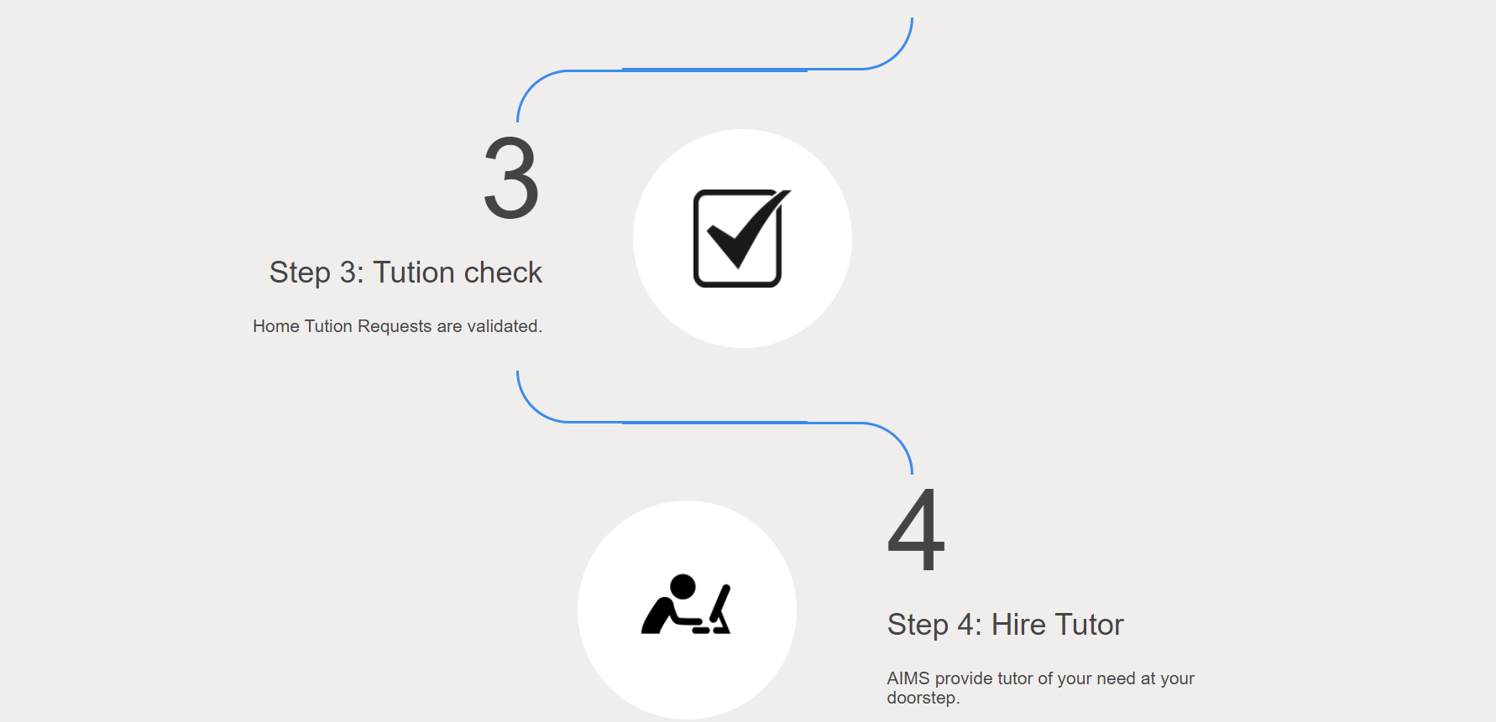

Slide 14
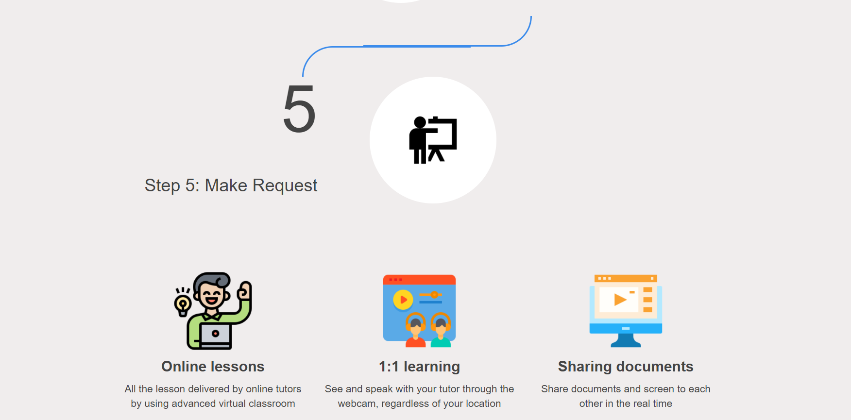
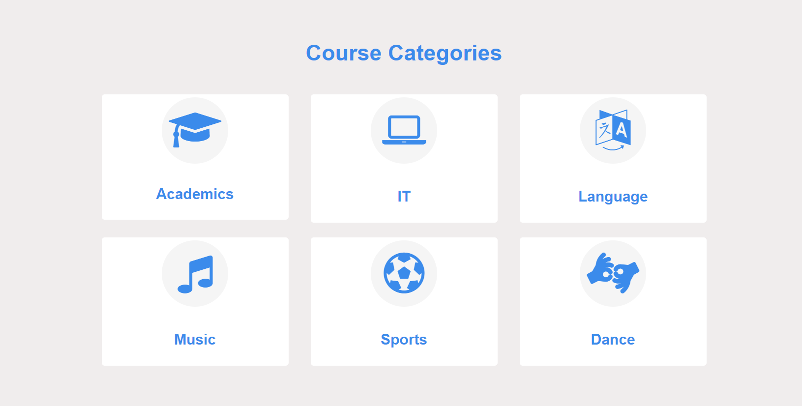

Slide 15

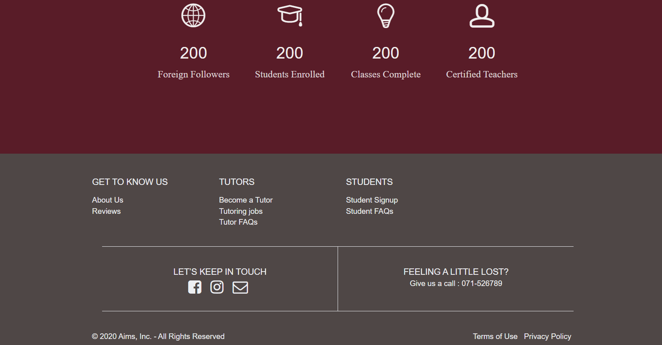

Slide 16
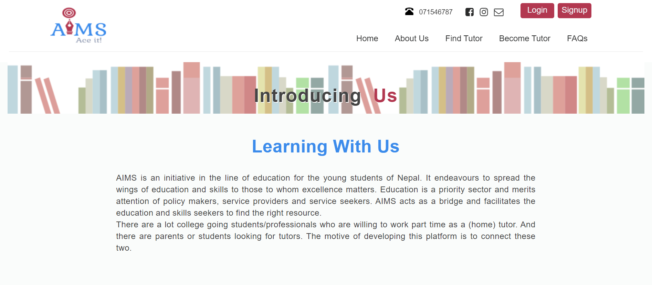
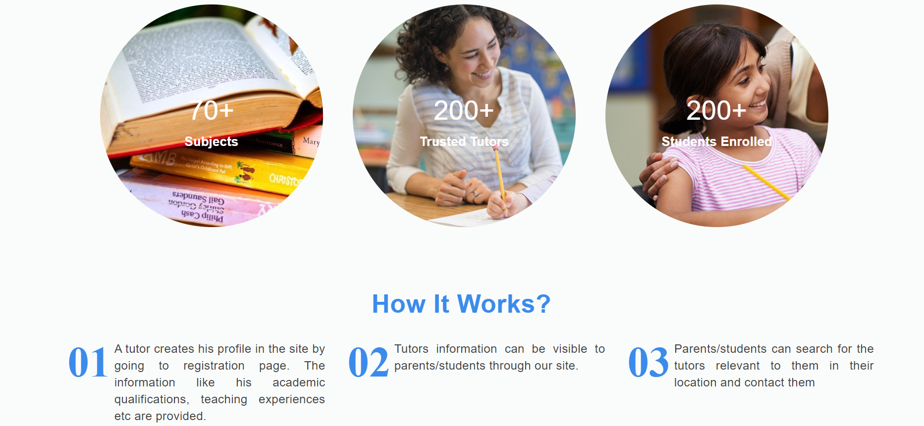
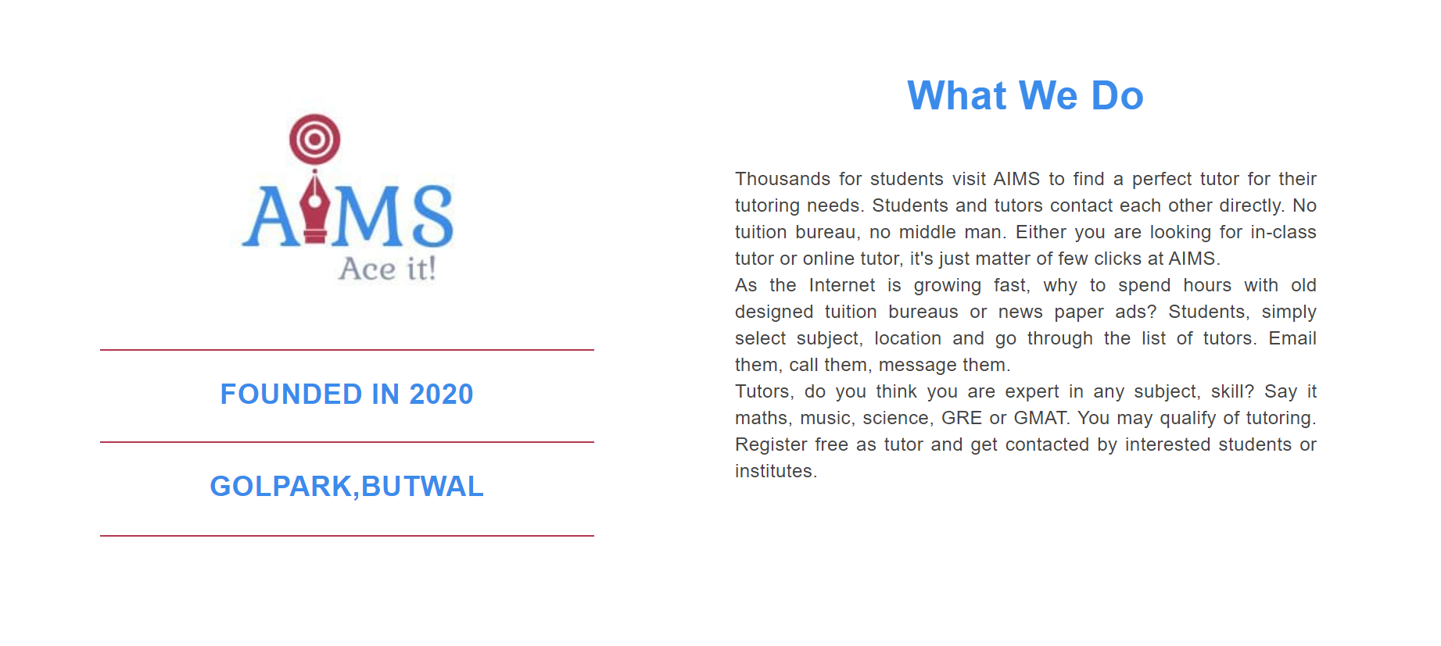

Slide 17
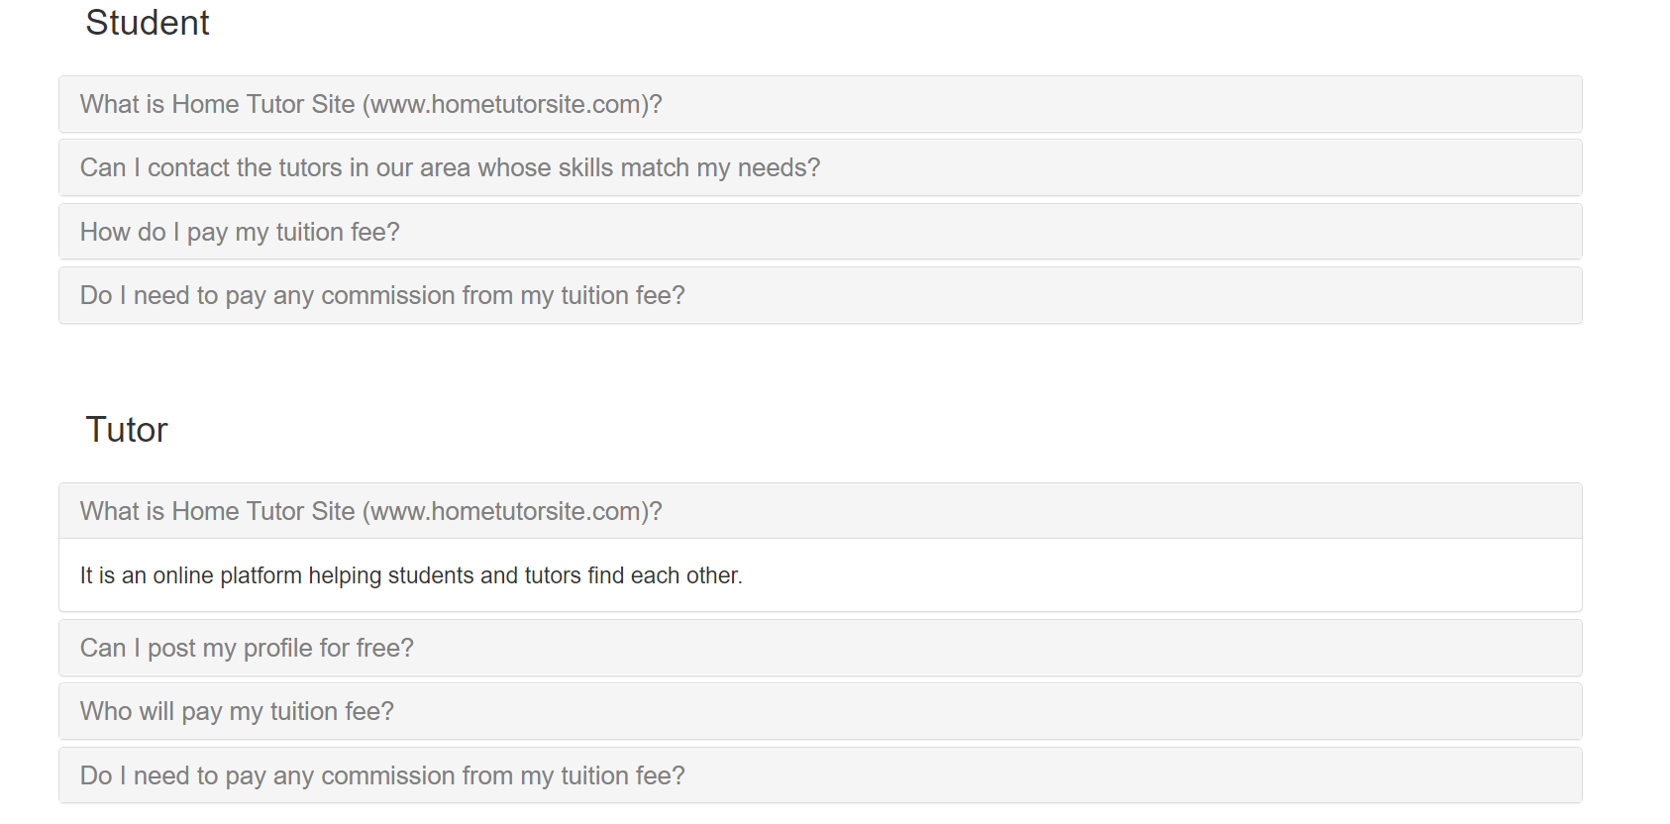

Slide 18
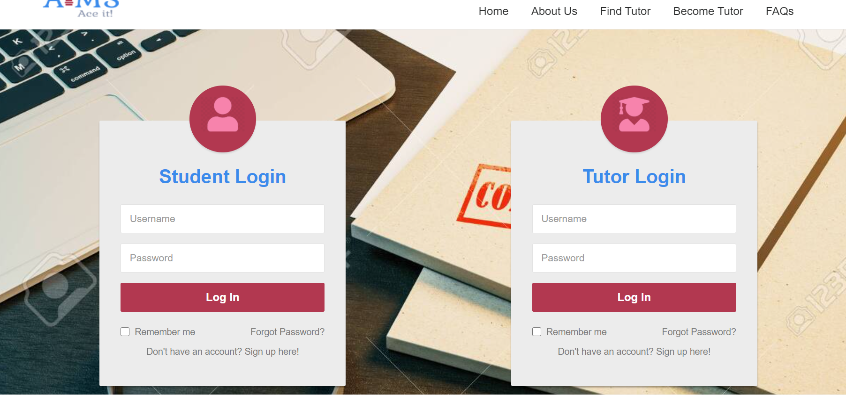

Slide 19
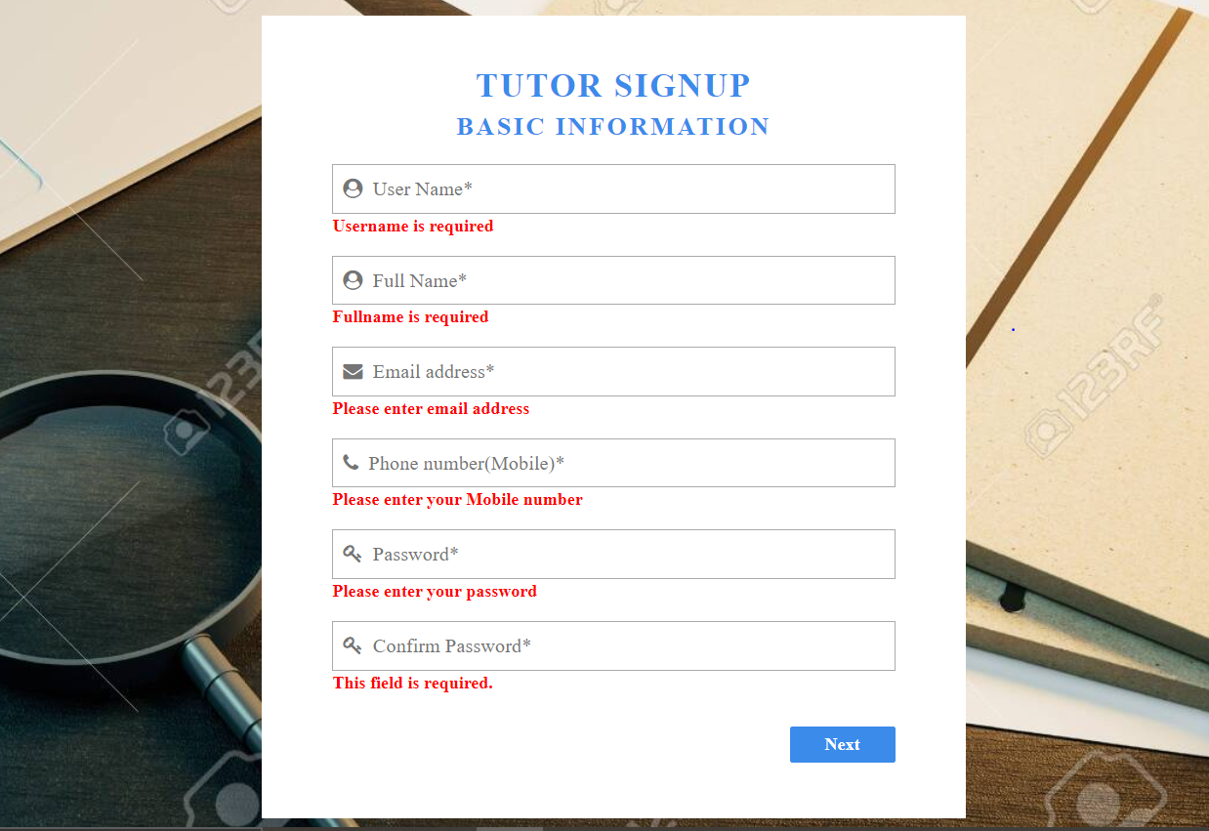

Slide 20
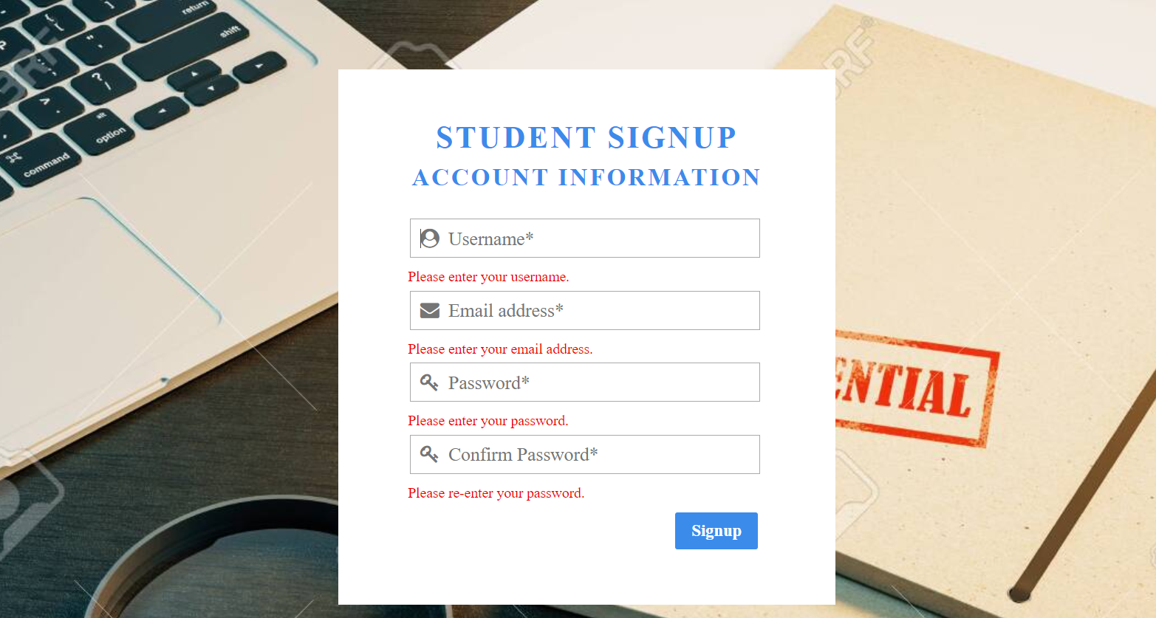

Slide 21
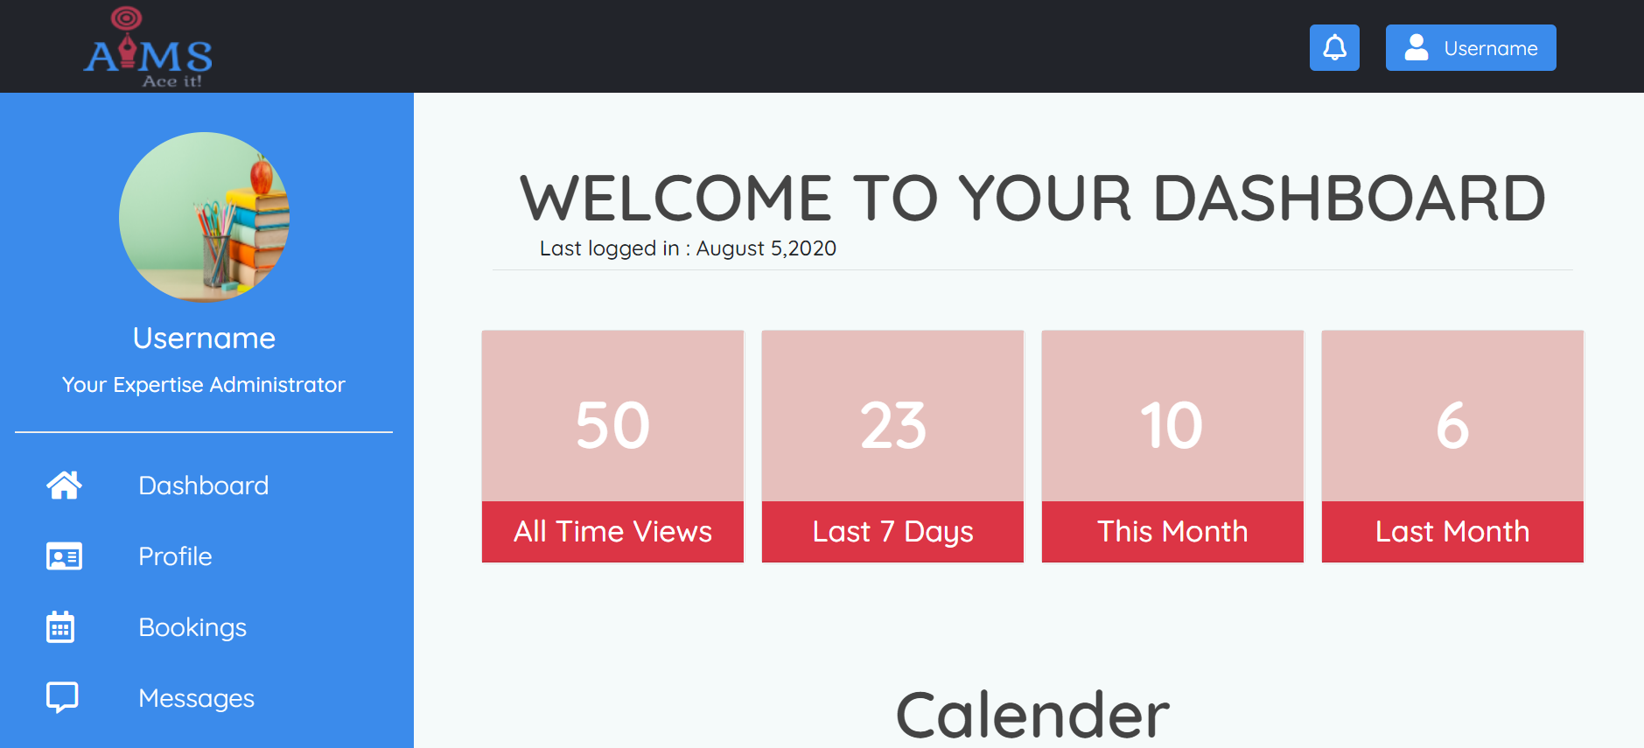

Slide 22
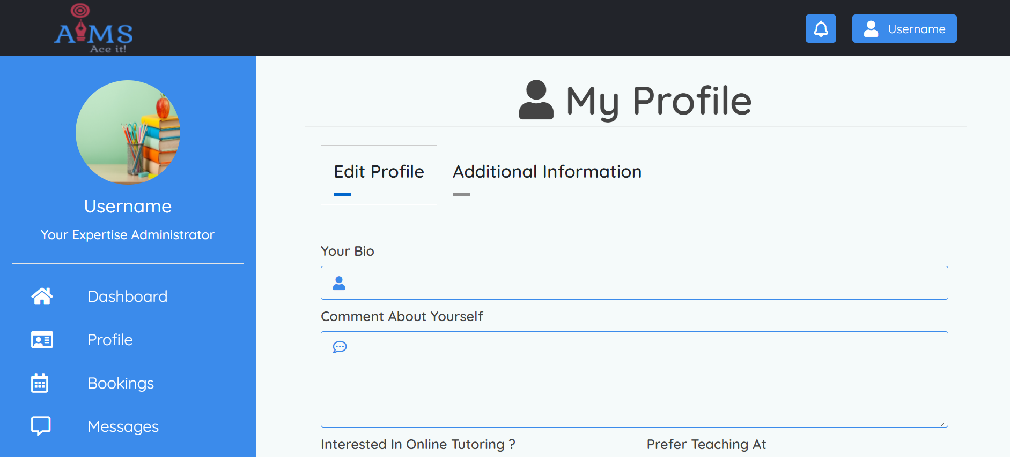
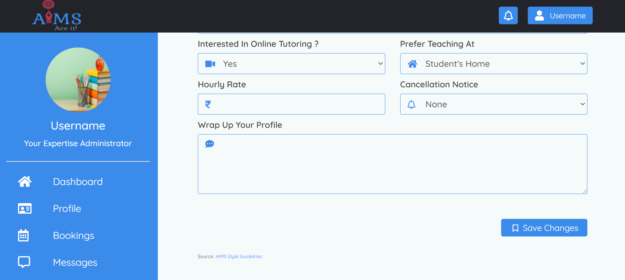

Slide 23
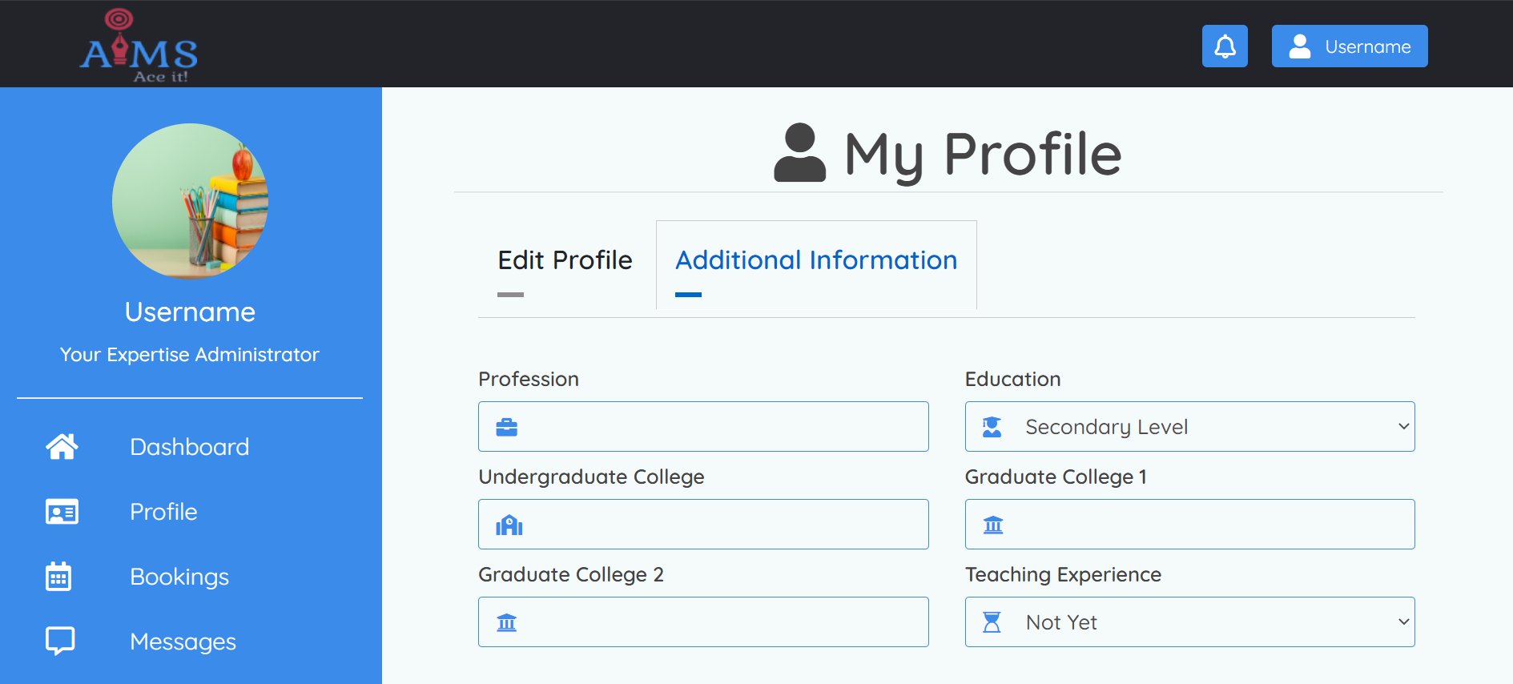
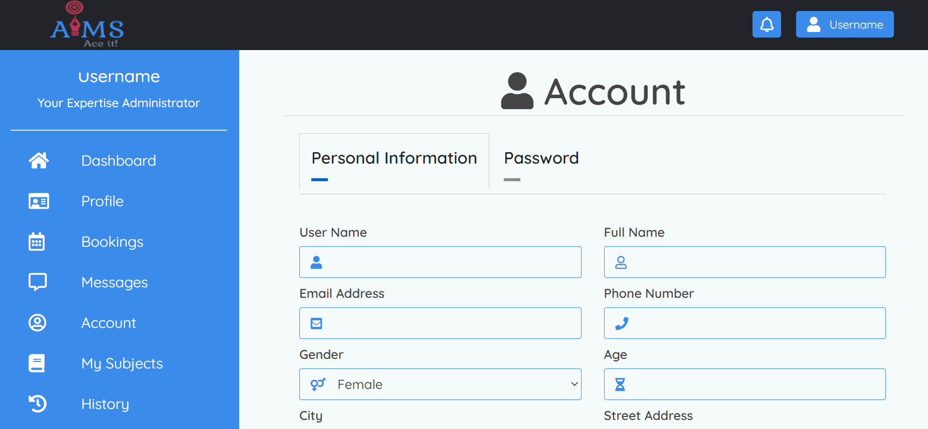

Slide 24
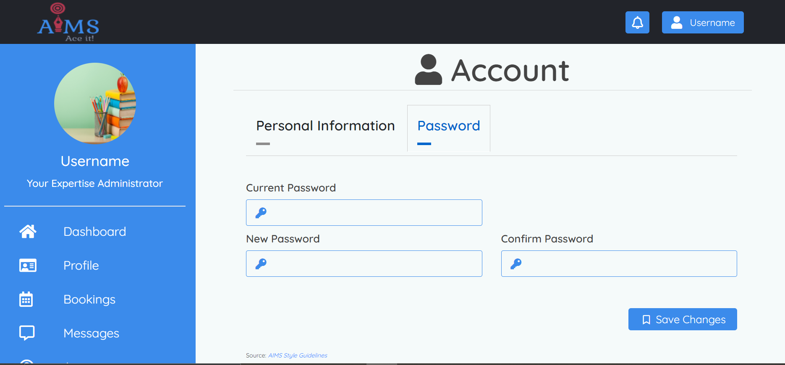

Slide 25
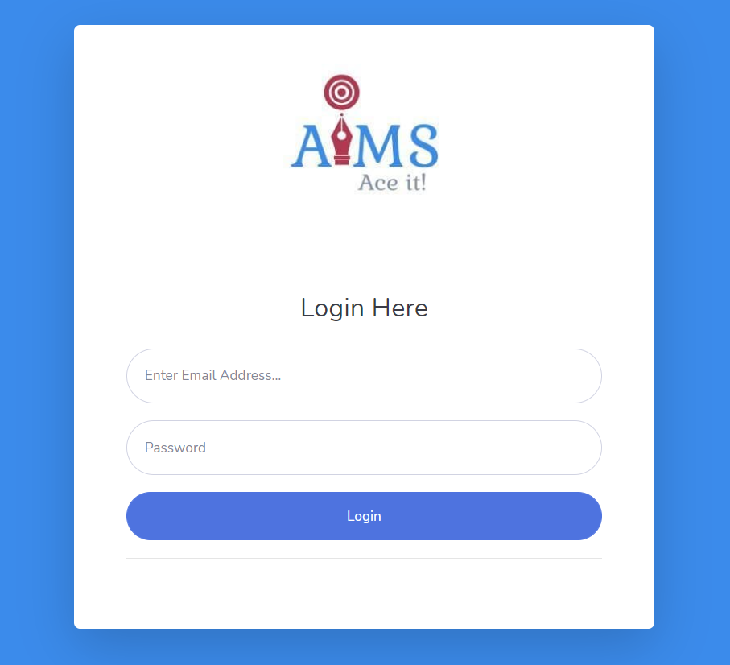

Slide 26
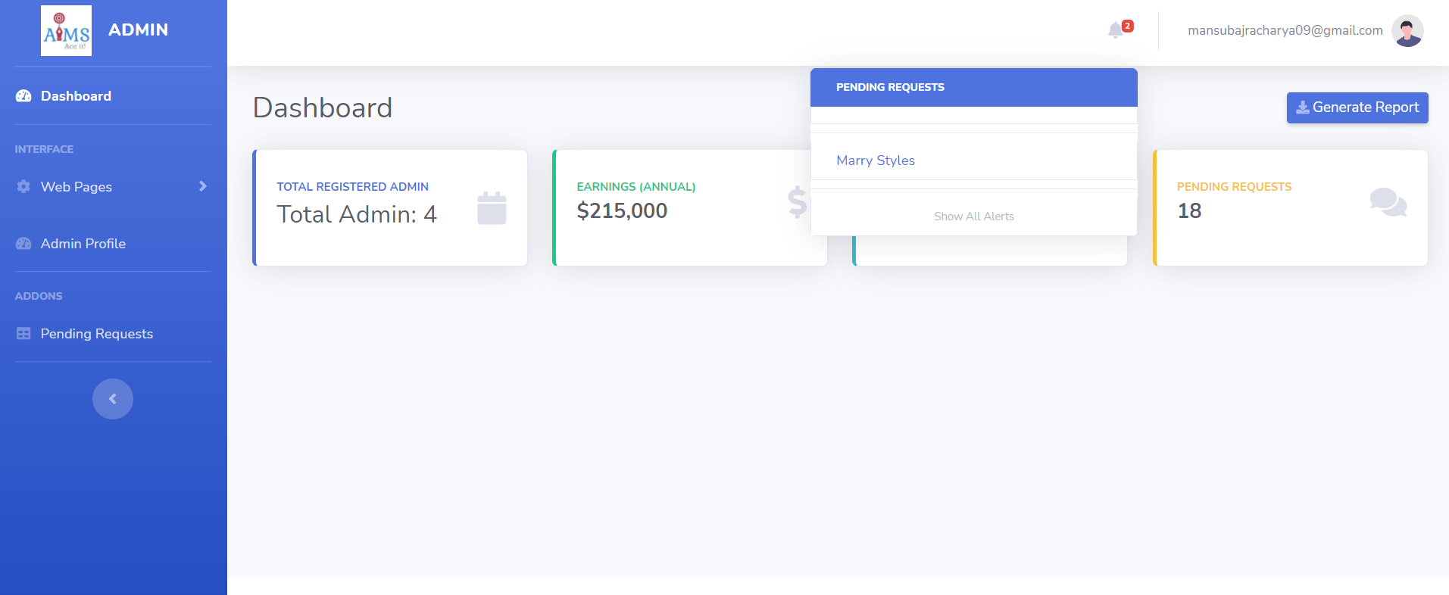

Slide 27
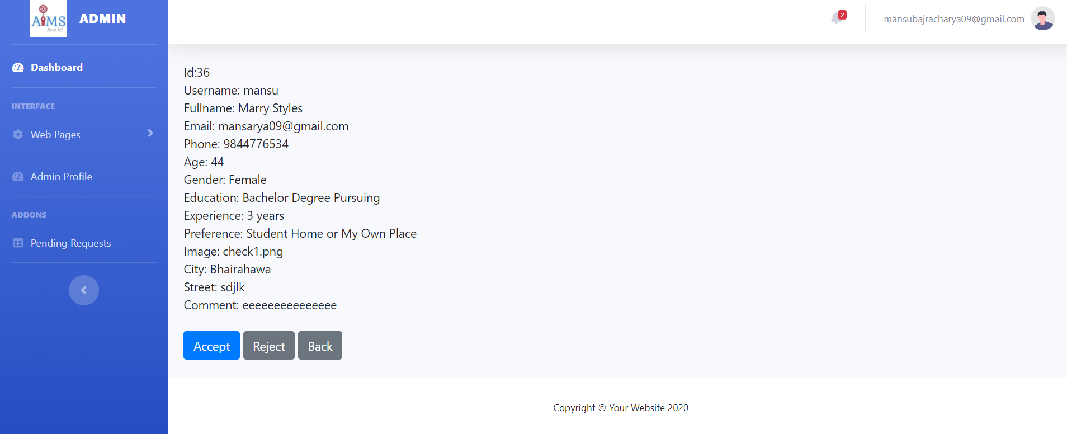

Slide 28
Thank you!

